Slide 1
Web Mapping in R
Instructor: Yanan Wu

Slide 2


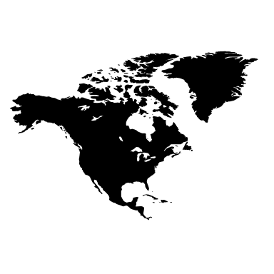



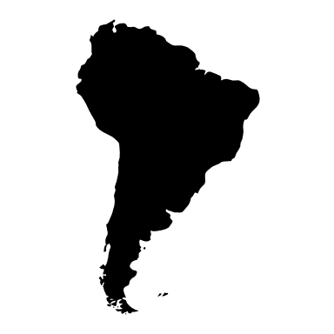


Leaflet package in R
Add Points, Lines, and Shapes
Integrate Spatial Data
Customize the Map
Interactive Features

Slide 3
Install R and RStudio
Link: https://posit.co/download/rstudio-desktop/
R: A powerful open-source programming language and software environment used primarily for statistical computing, data analysis, and visualization.
RStudio : An integrated development environment (IDE) designed to work with R. It provides a user-friendly interface that helps streamline coding, debugging, and project management.

